Slide 1
Retinal Image Analysis for multi-Disease Detection Challenge
BAG OF TRICKS FOR MULTI-DISEASE DETECTION OF RETINA IMAGES
Xinliang Wang, Yunchao Gu
Beihang University
School of computer science
Sixu Lu
Beijing Normal University
School of artificial intelligence

Slide 2
Contents
Bags of Tricks
Pre-processing, Data Augmentation, Optimizer, Learning Rate Scheduler, Disease Head, Loss Function
Implementation Details
Results

Slide 3
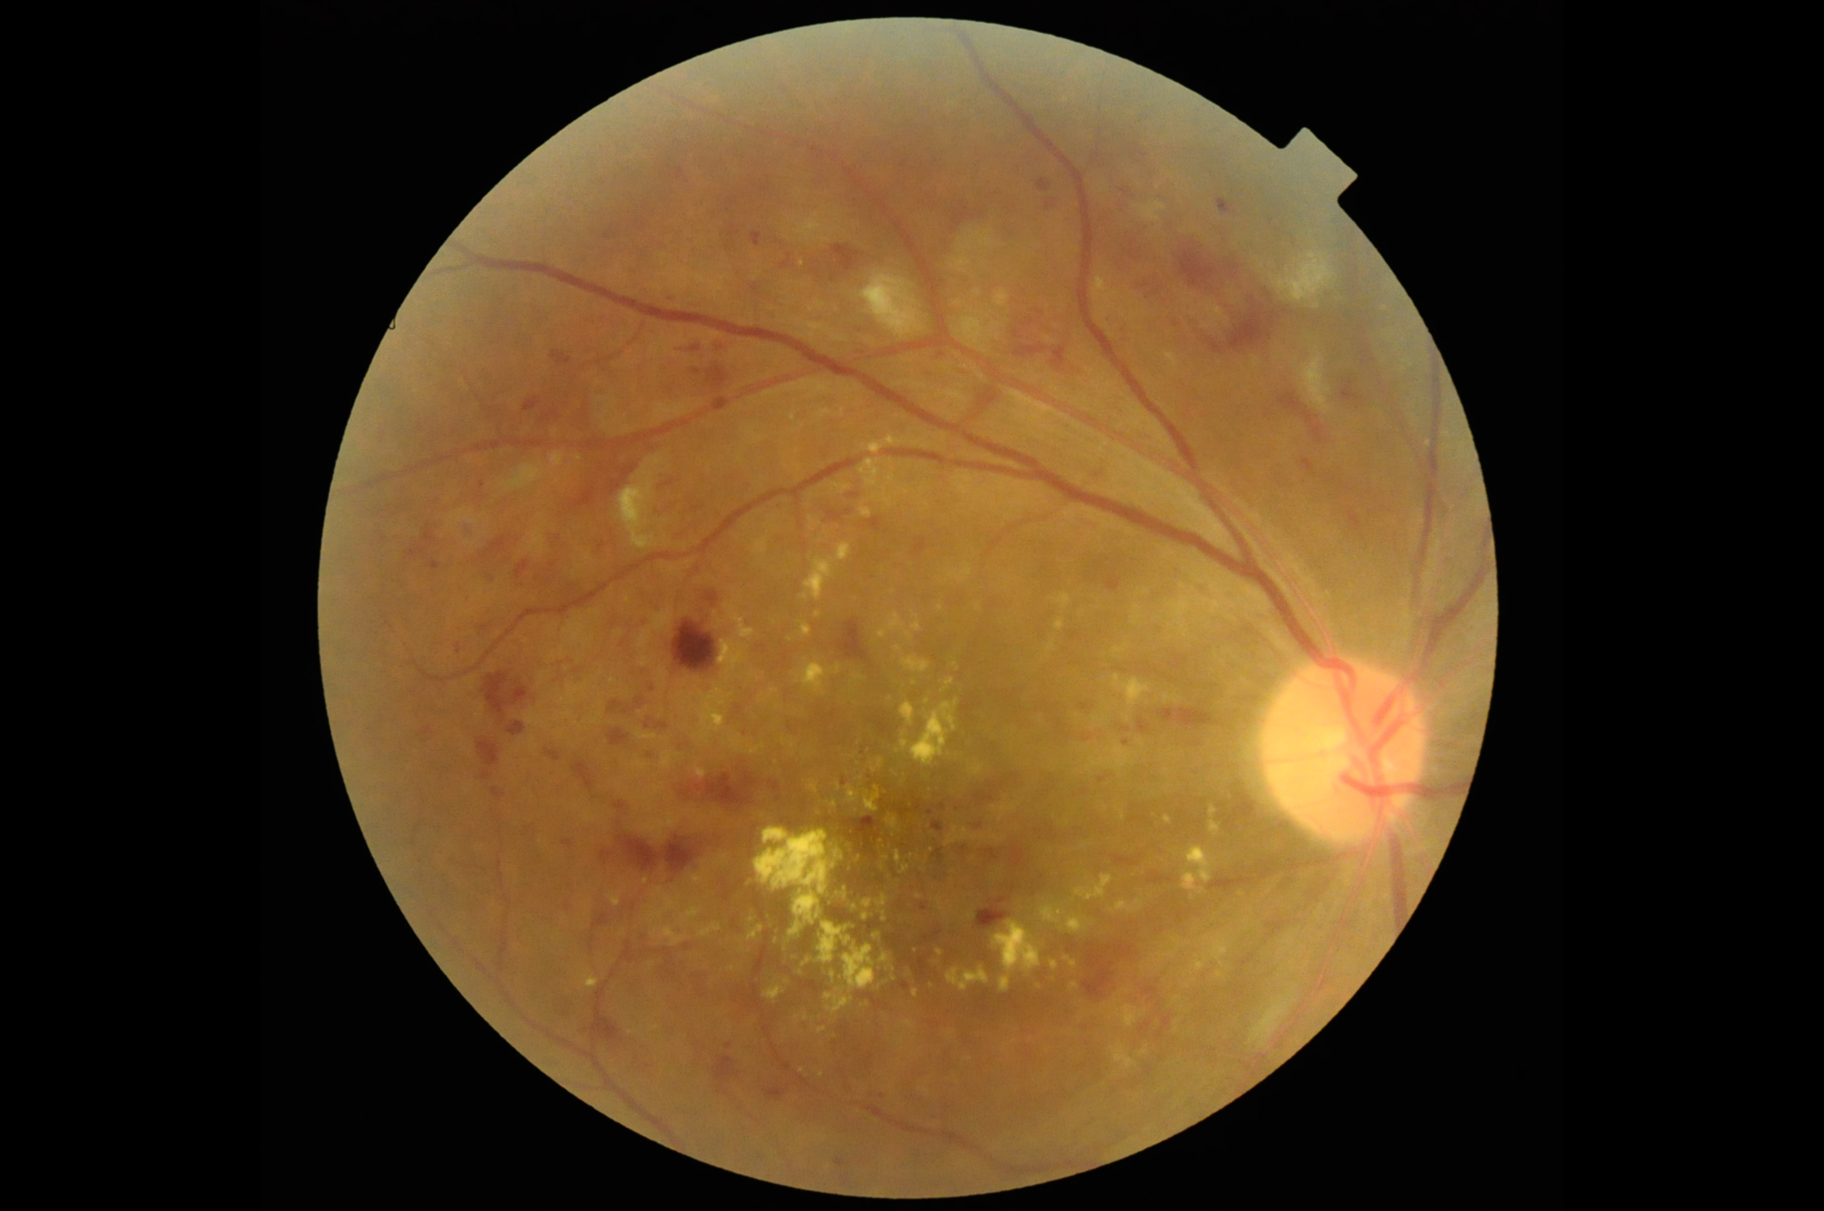
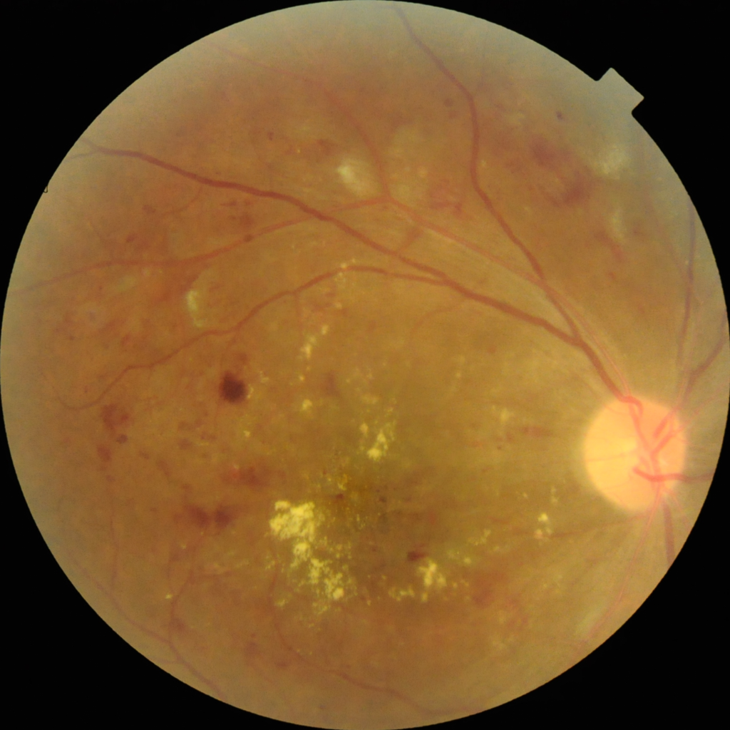
Pre-processing
remove
background
Cut off the black background to:
remove information that is not useful for classification;
reduce computational complexity.

Slide 4
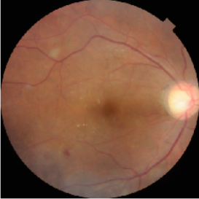
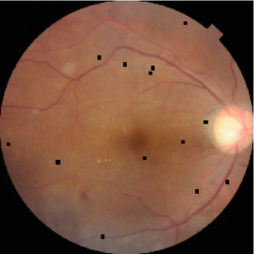
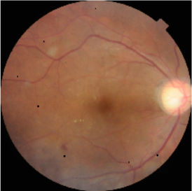
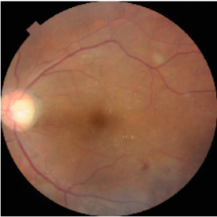
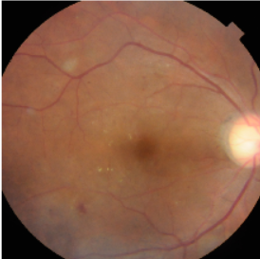
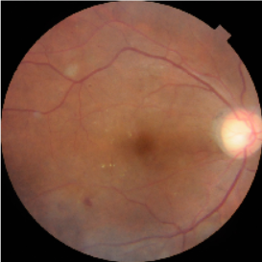
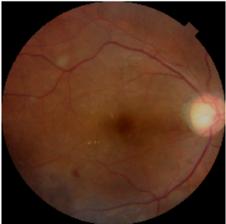
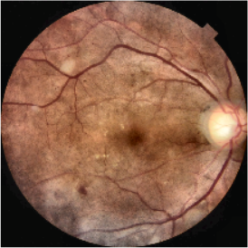
Data Augmentation
[1]
RandomResizedCrop
Cutout
CoarseDropout
HorizontalFlip
ShiftScaleRotate
HueSaturationValue
RandomBrightnessContrast
CLAHE

Slide 5
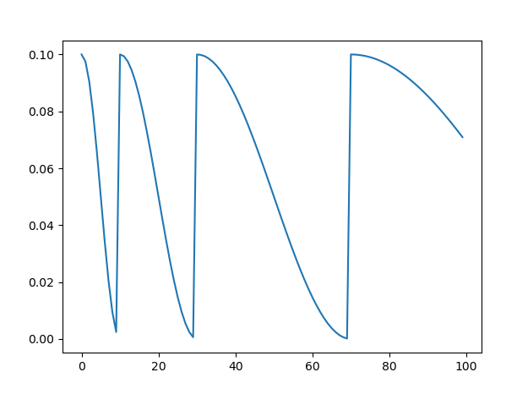
Optimizer & Learning Rate Scheduler
Optimizer: Ranger = RAdam^{[2]} + Lookahead^{[3]}
Learning Rate Scheduler: CosineAnnealingLR

Slide 6
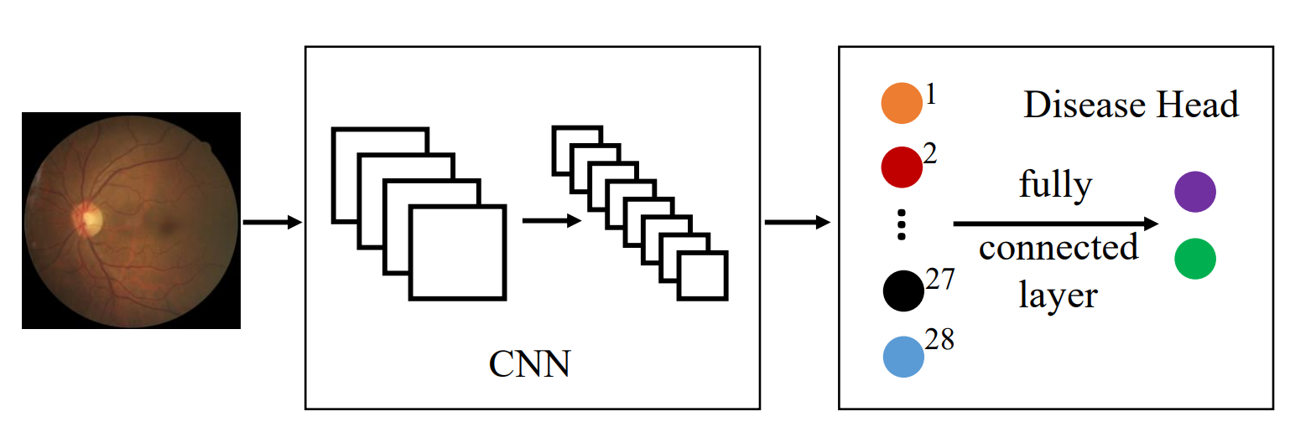
Disease Head
For task1, the Disease Head obtain more supervision information representing disease categories;
For task2, the weights pretrained by disease classification is helpful for specific multi-label and multi-classification.

Slide 7
Loss Function
The sub-challenge 1: Disease Screening is binary classification task, the basic loss function is the Cross Entropy (CE) loss. The sub-challenge 2: Disease Screening is binary classification task, we use the Binary Cross Entropy (BCE) loss as the loss function. In addition, when using the proposed Disease Head, the loss function of sub-challenge 1 is modified to αL_{CE} + βL_{BCE} .

Slide 8
Implementation Details
Backbone | Image Size | Validation Method
ResNet^{[4]} ResNext^{[5]} | 512×512 | Stratified K-fold (k=4)
GPU | Lr Schedule | Optimizer
Tesla V100 | CosineAnnealingLR | Ranger

Slide 9
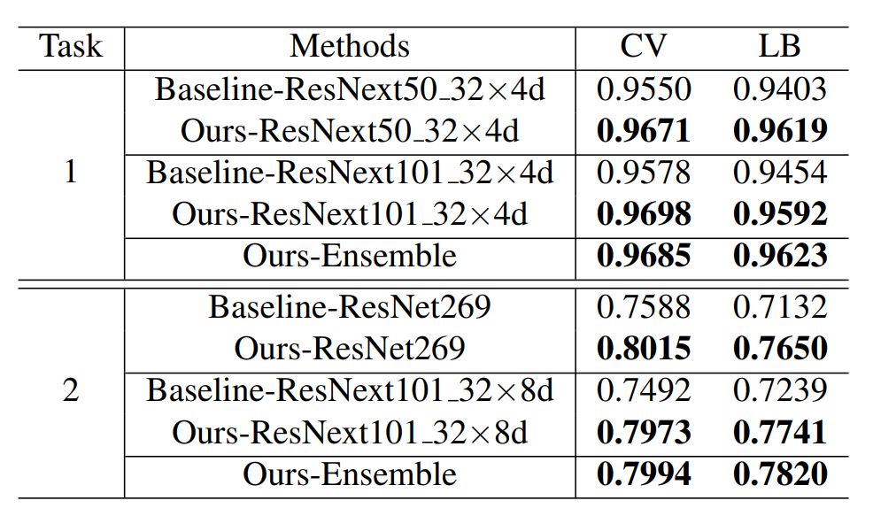
Results

Slide 10
Retinal Image Analysis for multi-Disease Detection Challenge
[1] Alexander Buslaev, Vladimir I. Iglovikov, Eugene Khvedchenya, Alex Parinov, Mikhail Druzhinin, and Alexandr A. Kalinin, “Albumentations: Fast and flexible image augmentations,” Information, vol. 11, no. 2, 2020.
[2] Liyuan Liu, Haoming Jiang, Pengcheng He, Weizhu Chen, Xiaodong Liu, Jianfeng Gao, and Jiawei Han, “On the variance of the adaptive learning rate and beyond,” arXiv preprint arXiv:1908.03265, 2019.
[3] Dinesh Jayaraman and Kristen Grauman, “Look-ahead before you leap: end-to-end active recognition by forecasting the effect of motion,” in European Conference on Computer Vision. Springer, 2016, pp. 489–505.
[4] Kaiming He, Xiangyu Zhang, Shaoqing Ren, and Jian Sun, “Deep residual learning for image recognition,” in Proceedings of the IEEE conference on computer vision and pattern recognition, 2016, pp. 770–778.
[5] A Emin Orhan, “Robustness properties of facebook’s resnext wsl models,” arXiv preprint arXiv:1907.07640, 2019.

